Slide 1
Business Location Recommendation with Four Squared & K-means clustering
Pool Equipment Supplies Ltd is opening their first store in the city of Richmond, VA and considering the 3 counties of Henrico, Chesterfield and Richmond City for their location.
Data driven decision making based on 3 criteria using Foursquare API location and venue data and k-means Clustering Algorithm
Location recommendations based on
Clustering of Areas, existing
Pool Count in the Area
Ranking of Pools amongst the venues in the Area

Slide 2
Data Section
Description | Count
Areas in the state of Virginia, USA | 6528
Areas in the 3 Counties of Henrico, Chesterfield, Richmond City | 190
Total number of Venues selected for the 190 Areas | 947
Areas with no venues identified by FourSquared API | 40
Total Areas considered | 150
Unique Venue Categories | 194
United States Board on Geographic Names location Data
FourSquared API
One Hot encoding
K-means Clustering
Cluster information, Pool Counts, Venue Ranking

Slide 3
Methodology
Download the txt file and create CSV File with Geo information of Areas in all the counties in the State of Virginia
Clean the Data – Select relevant features, verify formats and ensure no missing data
Evaluation and Validation of Data for fitment
Find Co-ordinates of Richmond using Nominatim API from geopy.geocoders library
Plot Map of Areas of the 3 Counties in Richmond that are considered
Visual Evaluation and Validation of Data for fitment for the Data Science Analysis
Using FourSquared API
Find venues for each area and their category field from JSON
Limit=100, Radius =500
Clean the dataset and prepare for One Hot Encoding Logic
Apply One Hot Encoding
Clean Data Again to prepare for k-means clustering- Group for each Area the category type and then assign the mean value for category
Using the data frame apply
k-means clustering
Filter areas with Pools and further analyze
Visualize the cluster on a Geo map using Folium and matplotlib and apply markers
Find the Count of Pools for areas with Pools
Get the ranking of Pools amongst the different venues in the Area
Create a result table with the 3 criteria – Cluster Label, Pool Count, Ranking of Pools
Final recommendation of the new Store Location

Slide 4
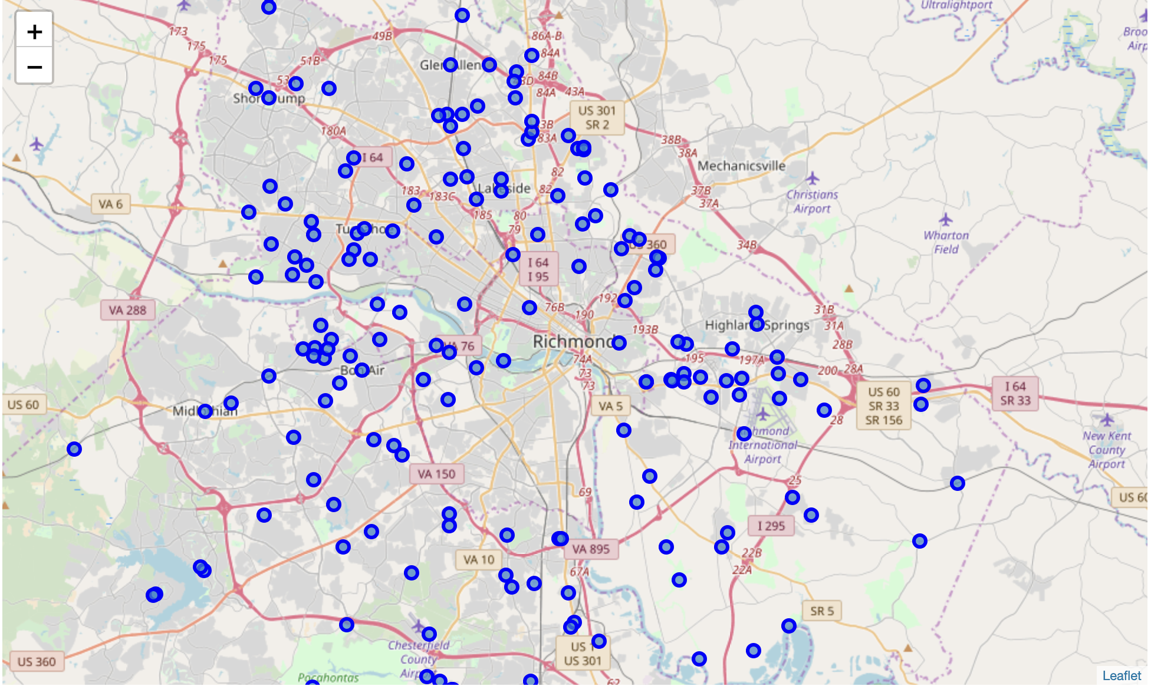
Visualization of 190 Areas in Richmond, VA

Slide 5
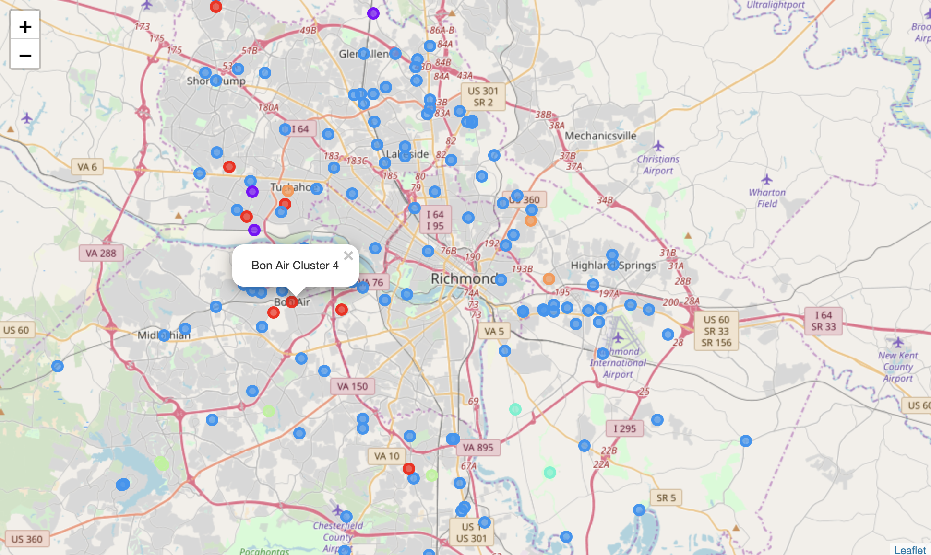
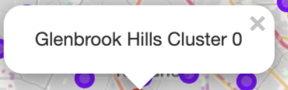
Visualization of 150 Areas Clustered for Richmond, VA

Slide 6
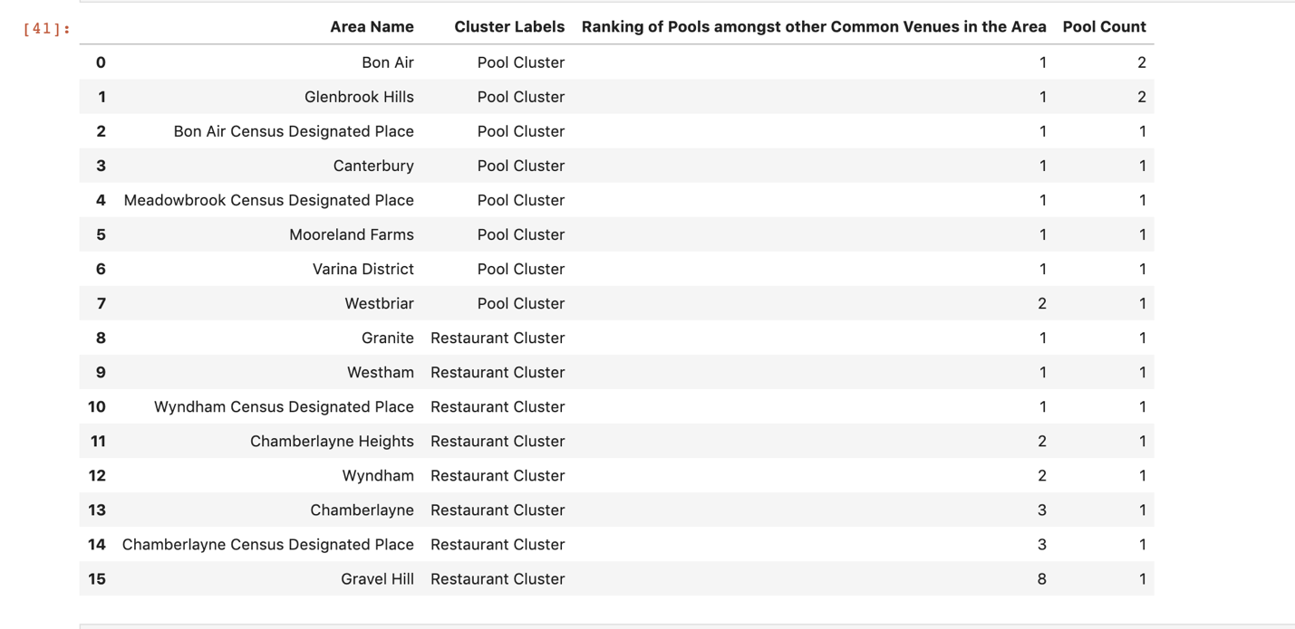
Bon Air and Glenbrook Hills wins

Slide 7

Thank You

